Slide 1

iAgroPod
Rural Ease of Farming Solution
By-:
Vibhanshu Kaushik , EEE
Aryan Yadav, ECE
Abhimanyu Arya, ECE
Project Mentor-:
Mrs. Neha Verma
Email- neha.verma87@gmail.com

Slide 2

Problem Statement
Land Degradation
Increasing food Demand
Land for cultivation
Quality of food
Fertilizers and other chemicals
Nearly one of the three people in the world did not have access to adequate food in 2020, that’s an increase of almost 320 million people in just one year.
Around 660 million people may still face hunger in 2030, in part due to lasting effects of the COVID-19
To feed those who are currently hungry—and the additional 2 billion-plus people who will live on the planet by 2050, our best projections are that crop production will need to increase between 10 and 60 percent.
Doubling crop production would require clearing 1 Billion hectares of land mostly Rainforest

Slide 3

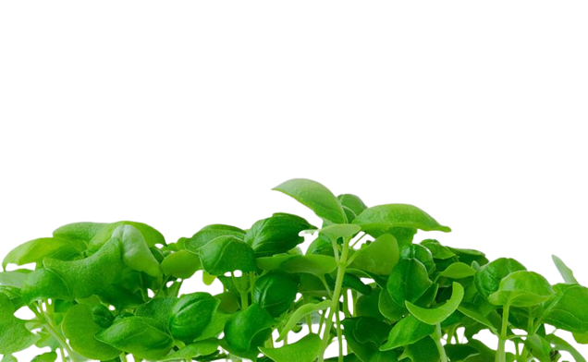
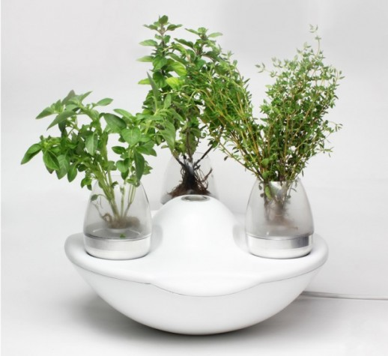
What is iAgroPod?
Intelligent method and model for cultivation
Does not require any soil as a medium for cultivation
Model describe the use of land very efficiently
Proposed two different model (Horizontal and vertical) for cultivation

Slide 4
Problems in Previous Model
Regular Attention is required
Controlled temperature
Controlled Humidity
Adequate proportion of Nutrients
Clogging should not be there
pH level should not change
Considering these factor atmost care is taken while growing plants using fogponics method.
All the problematic factors can be controlled by automation.
There can be machine to machine commutation which will lead to better environmental condition for the plants and can better take care of different level of nutrients better than operating manually.
Automation help in increasing the variety of crops that can be grown without much knowledge about plants.

Slide 5
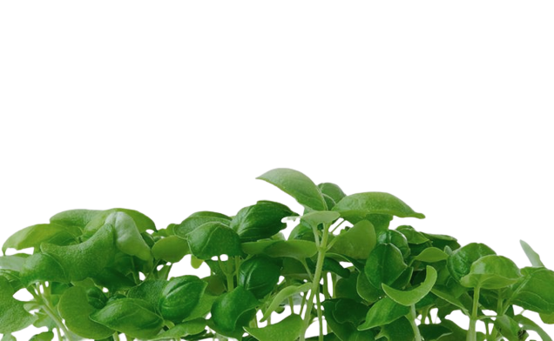
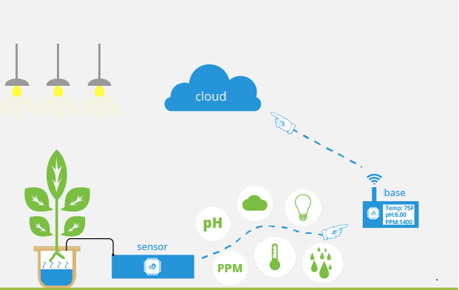
PROPOSED SOLUTION
Sensor embedded system of fogponics is the best solution for the unsupervised plant growth.
The use of artificial green house effect is help for the plants to have an healthy growth by maintaining the surrounding temperature.
IoT plays an important role by providing a Realtime data to owner of system allowing them to change the something if they want to change.
iAgroPod connected to Mobile App.

Slide 6
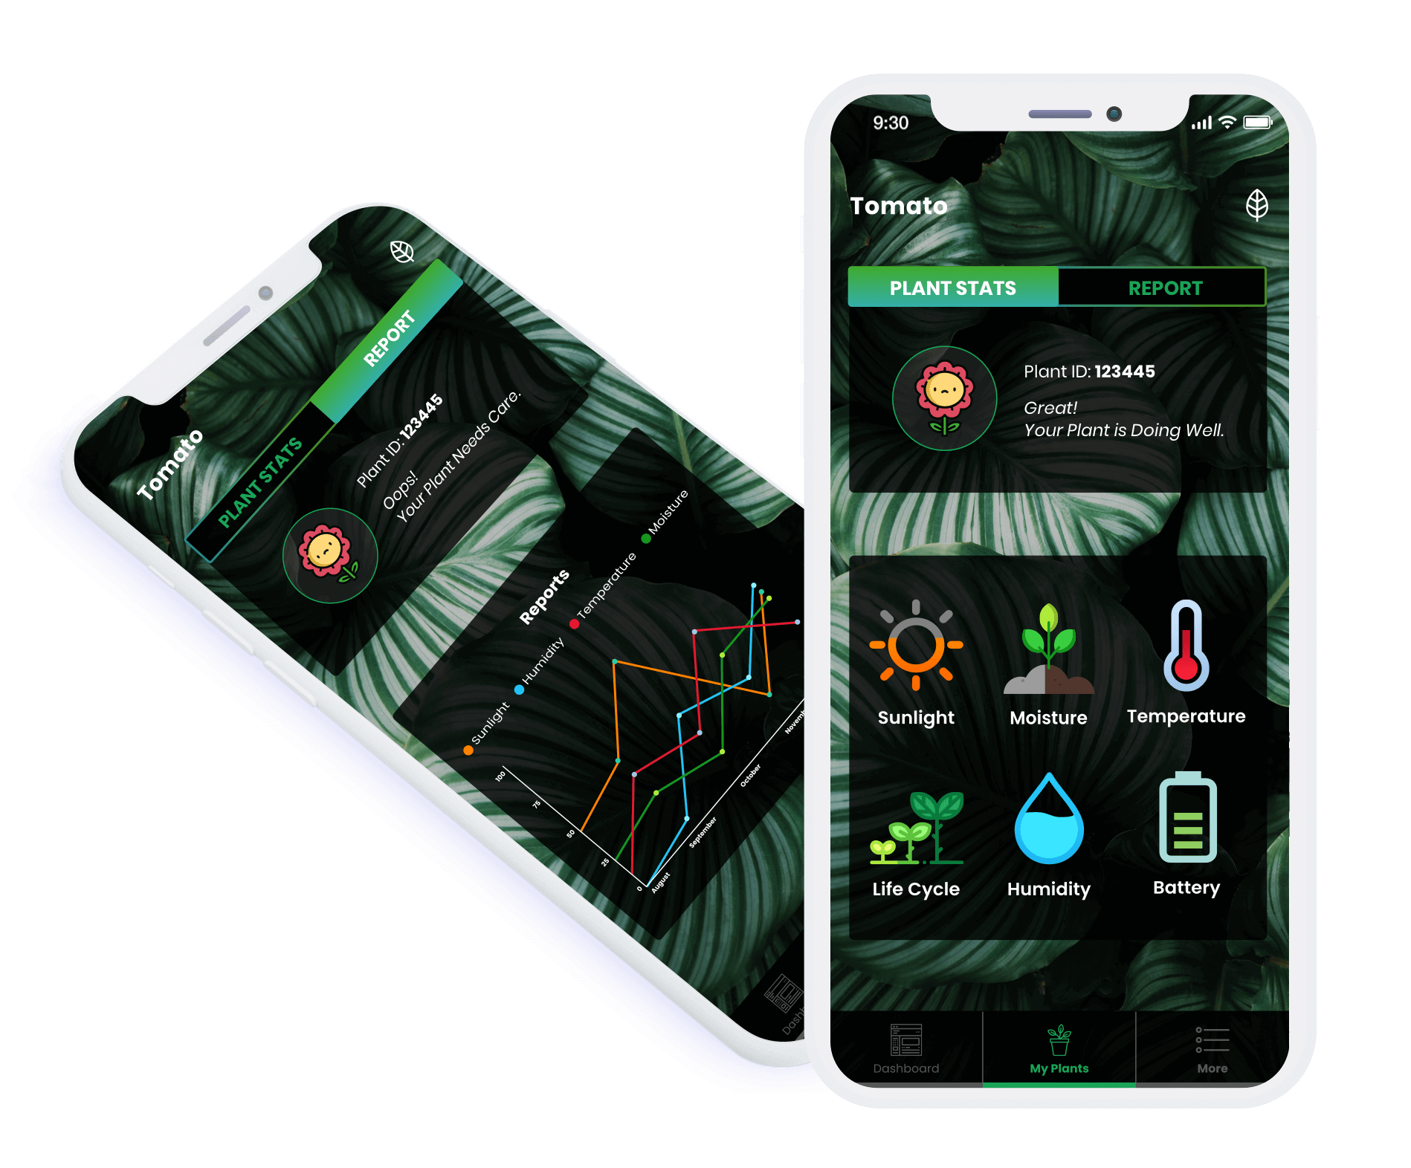
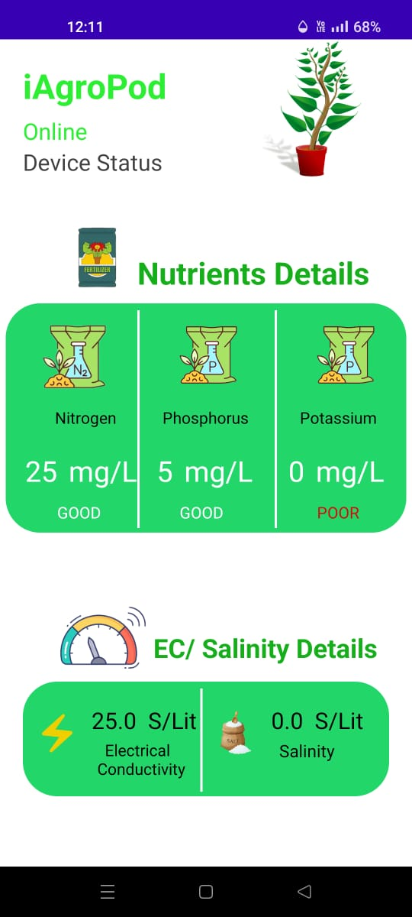
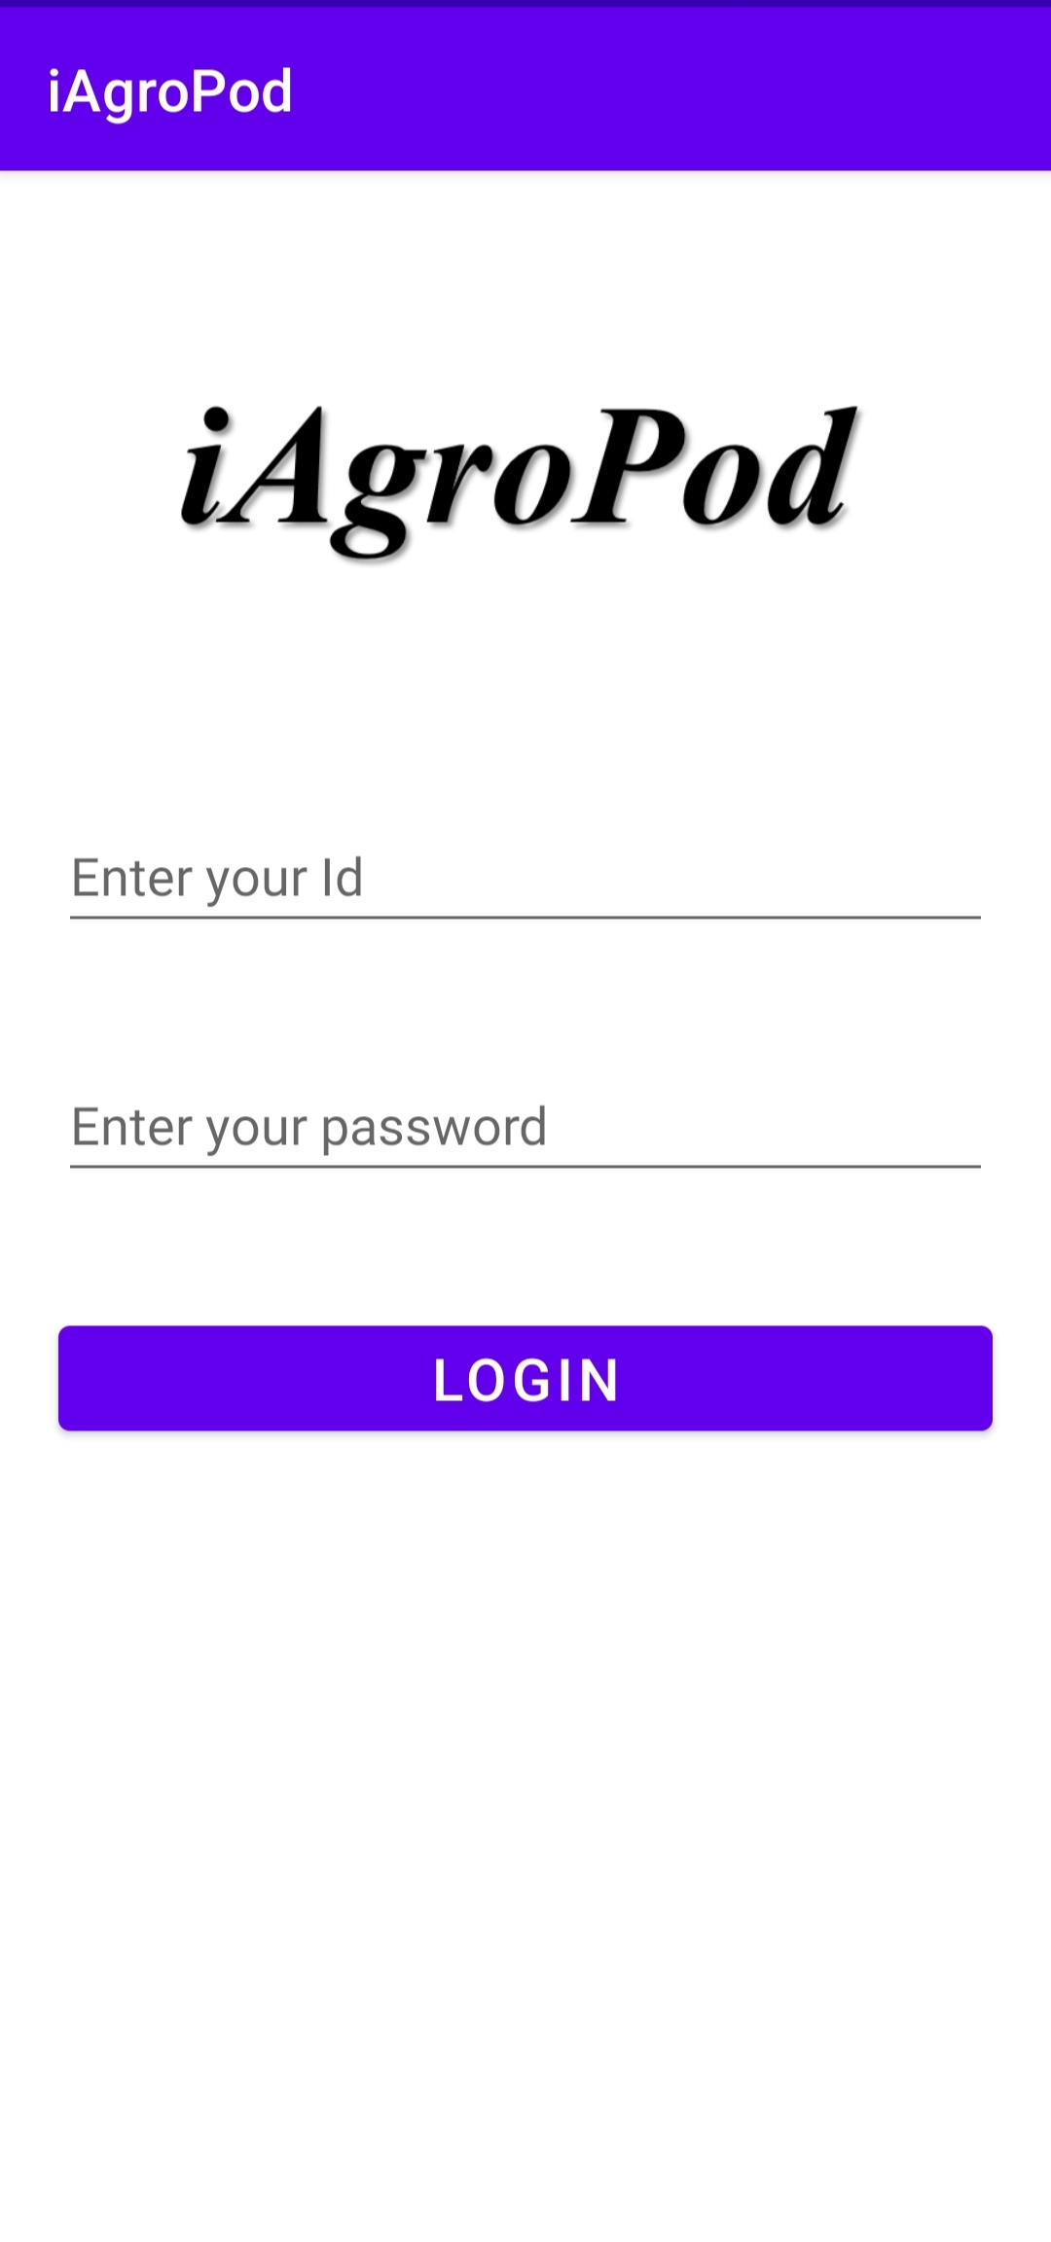
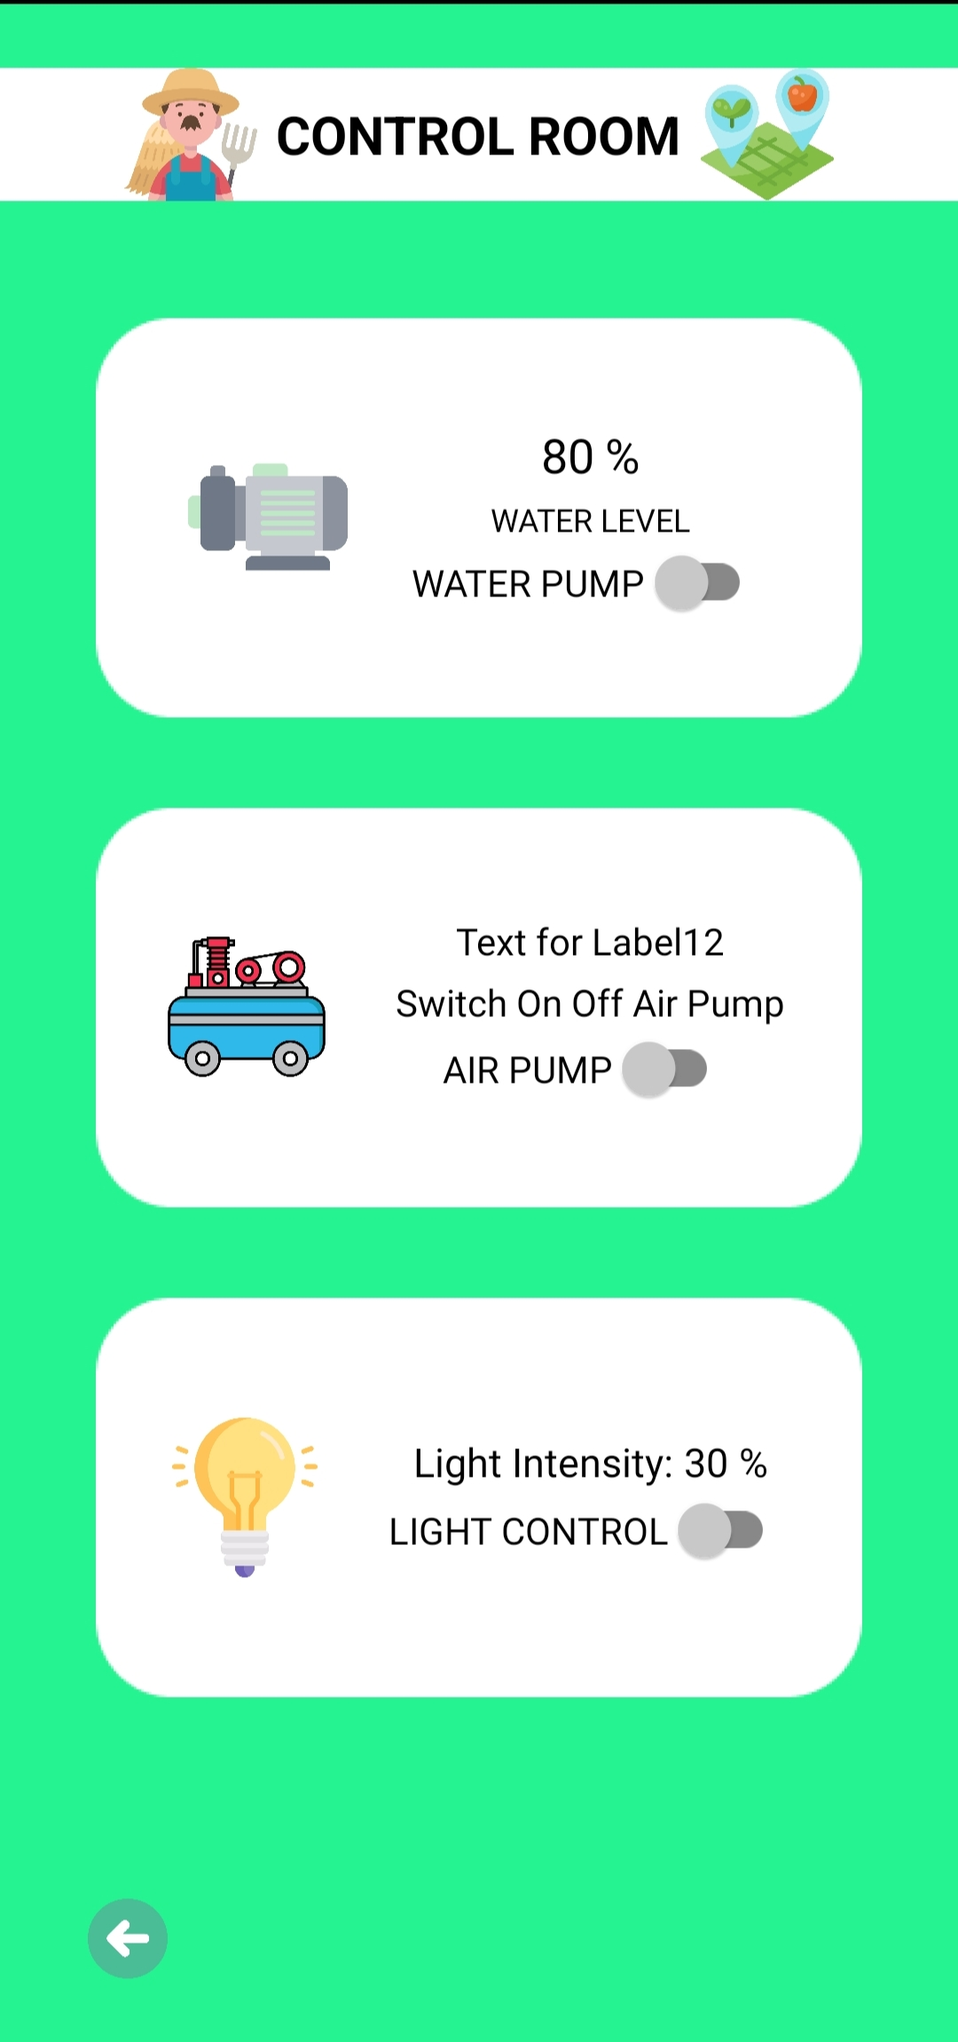
Personalized App
Cloud Database
Personalized App
Connected to IoT
Real Time Update

Slide 7
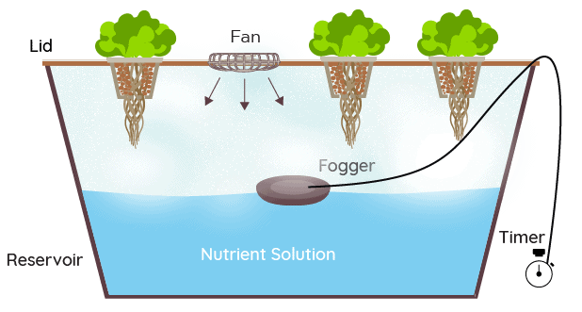
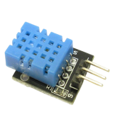
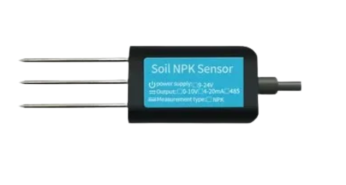
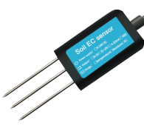
Design for Prototype
Temperature and Humidity Sensor
Glass Lid
EC Sensor
NPK Sensor

Slide 8
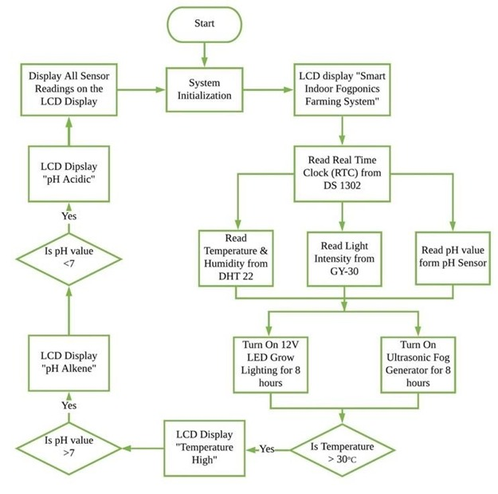
Work Flow

Slide 9
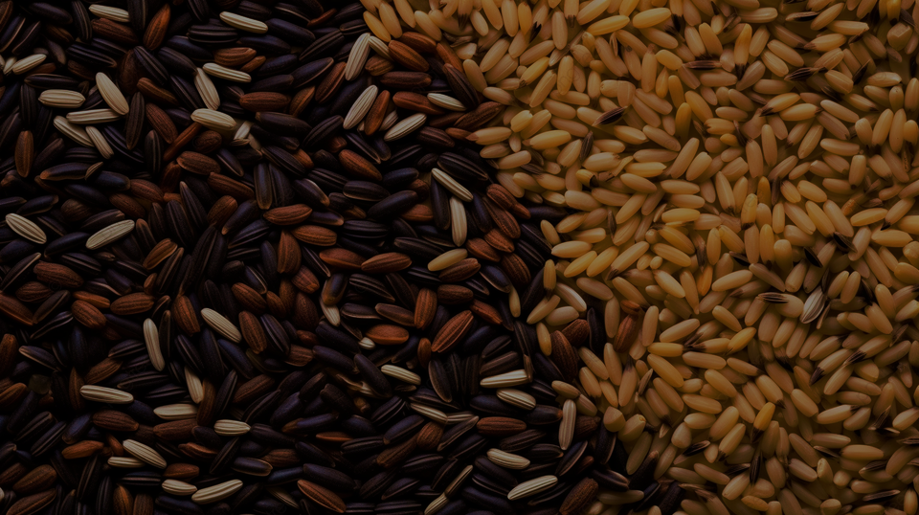



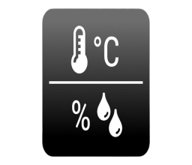
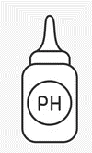

What’s New ?
Regular regulation of water according to the amount of water present in tank
Variable size of droplet can be formed according to the need
Regulation of nutrients according to the need of plants
After a regular time hardness of water is tested
Regular temperature and humidity check weather the conditions are suitable for plants or not
pH of water is most important factor for the healthier growth of plant so some additives are added at the time of pH fluctuation
An artificial green house effect is created so as to lead to healthier growth of plants.

Slide 10





MODEL
Key Partners
Farmers
Agro- Industrialists
Various Companies
House Holds
Channels
Through B2B
Through B2C
Decorative Model
Consumer Segment
Agriculture Model
Conventional Farmers
Greenhouse Owners
Environmental Enthusiasts
Organic Farming Segment

Slide 11
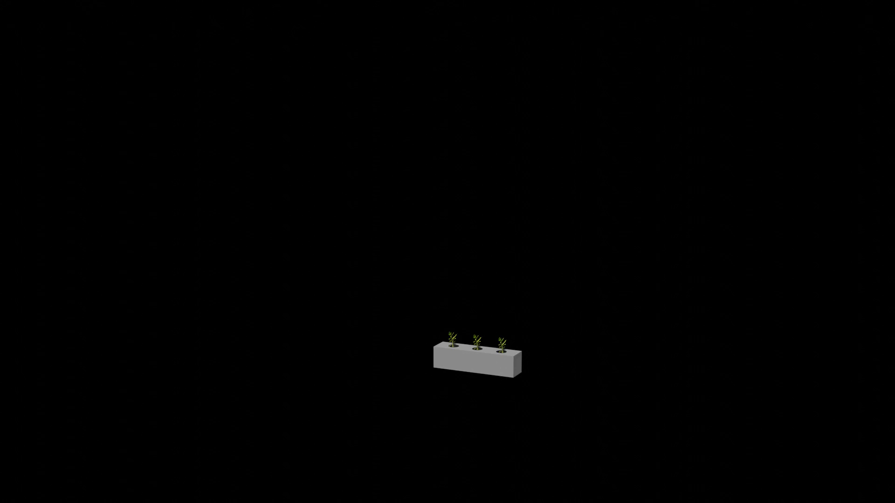
Ladder System

Slide 12






Business Model
Key Partners
Key Activities
Value Proposition
Costumer Relationship
Consumer Segment
Data Analysis
Data Security
Hardware
Troubleshooting
Dataset of different
samples
Testing of
sample cases
Affordable Model
for Plant lovers
Accurate Monitoring
Promotes Organic
Farming
Feedback Mechanism
Indirect Marketing
Approach
Conventional Farmers
Greenhouse Owners
Environmental Enthusiasts
Organic Farming Segment
Farmers
Agro- Industrialists
Key Resources
Relevant Dataset
Good Sever Space
Funds
Channels
Through B2B
Through B2C
Revenue Generation
Cost Structure
Through B2B
Through B2C
Tie-ups Urban Farming companies
9,000- 10,000 INR (including all the sensors)
7000 INR (without Mobile App)

Slide 13

Thank You

